Slide 1
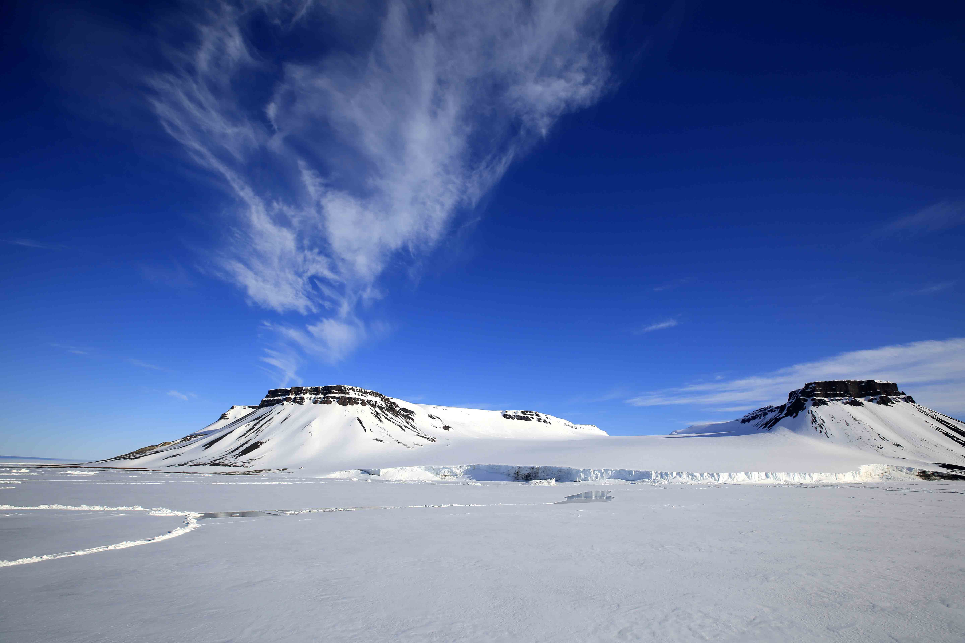
How to continue a story?

Slide 2
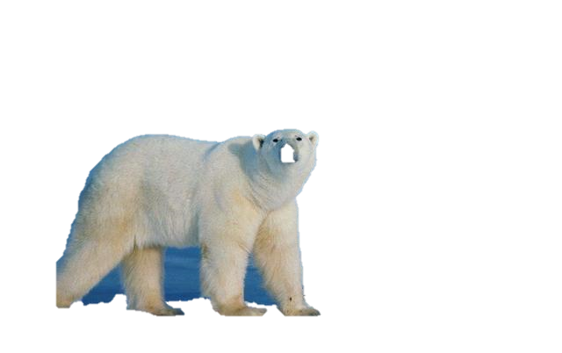
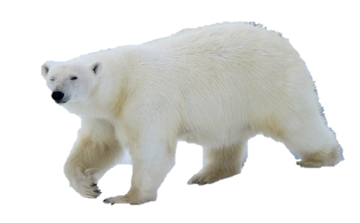
标准解读

Slide 3
What makes a good continuation writing?
阅卷时考虑以下几个方面：
(1)与所给短文及段落开头语的衔
接程度;
(2)内容的丰富性;
(3)应用语法结构结构和词汇的丰
富性和准确性;
(4)上下文的连贯。
第五档（21-25分）
（1）与所给短文融合度高，与所提供的段落开头语衔接合理;
（2）所使用语法结构和词汇丰富、准确;
（3）有效地使用了语句间的连接成分， 所续写短文结构紧凑。

Slide 4
段落开头语与后续语的衔接。
后续两段间的衔接；
原文与后续的衔接；
衔接
内容多视角、多维度；
语言结构，词汇选用多样。
丰富
准确
情感表达准确；
语言描述准确。

Slide 5
Stand up if you think you can…
能做到续写内容段落间、与段落开头语以及原文高度衔接。
能做到续写内容多视角、多维度以及语言结构、词汇丰富。
能做到情感表达以及语言描述准确。
能做到在规定时间（ 25-30分钟）内完成上述三项任务。

Slide 6
真题演练

Slide 7
Paragraph 1:A few minutes later, the bear headed back to our camp...
key information
Why was the bear here before? What did it do?
What would the bear do next?
the bear headed back
hunted ,attacked , was scared off
attack again
？
段落开头语与后续语的衔接；原文与后续的衔接。

Slide 8
Paragraph 1:A few minutes later, the bear headed back to our camp...
attacked
reacted
The polar bear
Elli and “I”
Result ?
Paragraph 2:At that very moment, the helicopter arrived.
后续两段间的衔接；原文与后续的衔接。

Slide 9
Paragraph 1:A few minutes later, the bear headed back to our camp...
The bear was angry and attacked the fence fiercely.
Elli and I were frightened and try to do something to protect ourselves.
Result ?
Elli and I were in a dangerous situation.
段落开头语与后续语的衔接；后续两段间的衔接；原文与后续的衔接。

Slide 10
Paragraph 1:A few minutes later, the bear headed back to our camp...
The bear was angry and attacked the fence fiercely.
his act
his appearance
charged at the fence
exposed his teeth
glared at..
smashed his paws
stood on his back legs
…
red
eyes
big, full of blood
Result ?
massive,
powerful
paws
mouth
内容多视角、多维度；语言结构，词汇选用多样。

Slide 11
Paragraph 1:A few minutes later, the bear headed back to our camp...
Elli and I were frightened and try to do something to protect ourselves.
Elli
“I”
action？
feeling？
expression？
tools？
Result ?
内容多视角、多维度；语言结构，词汇选用多样。

Slide 12
Paragraph 1:A few minutes later, the bear headed back to our camp...
叙述者情感？
原文语言风格？
Result ?
情感表达、语言描述准确

Slide 13
What are the language features of the original story?
personification
The hungry bear followed his nose to our camp, which was surrounded by a high wire fence. He pulled and bit the wire. He stood on his back legs and pushed at the wooden fence posts.
action verbs
he just kept trying to tear down the fence with his massive paws. We yelled at the bear, hit pots hard, and fired blank shotgun shells into the air.
So I approached our uninvited guest slowly and, through the fence, sprayed him in the face.

Slide 14
What are the language features of the story?
Careful use of adjectives and adverbs
As Elli and I cooked dinner, a young male polar bear…
The hungry bear followed his nose to our camp, which was surrounded by a high wire fence.
Terrified, Elli and I tried all the bear defense actions we knew.
…fired blank shotgun shells into the air
…he just kept trying to tear down the fence with his massive paws
So I approached our uninvited guest slowly and, through the fence, sprayed him in the face.
With an angry roar, the bear ran to the lake to wash his eyes.

Slide 15
What are the language features of the story?
Participle
Making the best of this close encounter, I took some pictures of the bear.
Adverbial phrases
With an angry roar, the bear ran to the lake to wash his eyes.
…through the fence, sprayed him in the face.

Slide 16
Paragraph 1:A few minutes later, the bear headed back to out camp...
The bear was angry and attacked the fence fiercely.
Elli and I were frightened and try to do something to protect ourselves.
Result ?
Elli and I failed to scare off the bear and were in a dangerous situation.

Slide 17
One possible version
Paragraph 1:A few minutes later, the bear headed back to our camp...
He exposed his sharp teeth, glaring at us as he ran forward. And again the bear stood on his back legs, wanting to break the fence like a monster. It seemed that his mouth was full of blood and his eyes were red with anger. Seeing such terrible sight, I could feel a coldness flooding from my back. Elli was frozen there, with the mouth widely open. I had to take action, so I picked my courage and tried to frighten him away with the pepper spray, but finally failed.

Slide 18
Paragraph 2:At that very moment, the helicopter arrived.
Read the given sentence.
Find the key information.
Keep asking questions.
Refer back to the original reading material when necessary.
Result ?
段落开头语与后续语的衔接；后续两段间的衔接；原文与后续的衔接。
内容丰富，多视角、多维度；语言结构，词汇选用丰富多样。
情感表达、语言描述准确

Slide 19
What might happen after the helicopter arrived?
The helicopter…
My wife Elli and I…
The polar bear …
The fence…
My camera…
…

Slide 20
What might happen to the polar bear?
my wife Elli and I had a single goal：to photograph polar bears.
Elli and I tried all the bear defense actions we knew.
Sometimes loud noises like these will scare bears off.
The camp manager suggested I use pepper spray. The spray burns the bears’ eyes, but doesn’t hurt them.
The polar bear should be alive and might have something for dinner.

Slide 21
One possible version
Paragraph 2: At that very moment, the helicopter arrived.
It landed near our camp and its loud noises scared the bear. He looked annoyed and charged at us again. I cried out, “Watch out!” We instantly stepped away and ran as fast as we could to the helicopter. Thank My God! We succeeded in climbing onto the helicopter, breathing a sigh of relief. Looking down at the bear, we found that he was eating the bread we just made. Several hours later, we arrived at home safe and sound, but we realized that we should do something to help the bears.

Slide 22
技巧提炼

Slide 23
原文与后续的衔接；
后续两段间的衔接；
段落开头语与后续语的衔接。
内容多视角、多维度；
语言结构，词汇选用多样。
衔接
Note ：时态，故事叙述者与原文一致；情节一定要回照原文，合情合理。
Note ：高立意、正能量；
传递积极的情感态度
丰富
Read the given sentence first.
准确
情感表达；
语言描述。
Find the key information.
Keep asking questions.
Note ：抓牢原文情感主线，关注主人公情感变化。
研究并遵从原文语言风格。
Refer back to the original reading material if necessary.

Slide 24
Homework
1. Please finish the whole story.
2. Please proofread your writing from the following four aspects: punctuation, spelling, grammar and choices of words.
3. Exchange your writing with your friends and give possible suggestions from the plot and description of details.

Slide 25
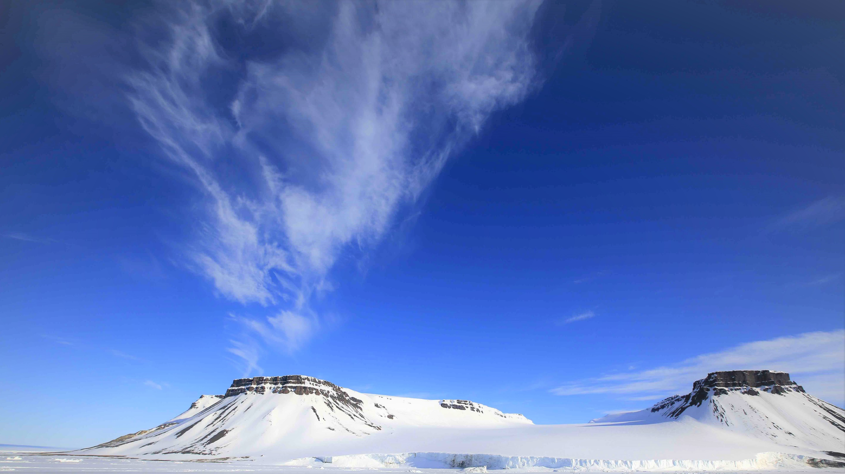
Thank you

